Slide 1
Multimedia Database (MMDB)
Presented by : Laphrangki Khyriem
Rollno : 14
MCA 4th Sem

Slide 2

Contents
1.What is Multimedia and Multimedia Data
2.Types of multimedia data
3.What is Multimedia Database(MMDB) and its Types
4.What is Multimedia Database Management System(MMDBMS)
5.Characteristics of MMDM
6.Requirements of Multimedia Database(MMDB)
7. Issues and challenges
8. Applications
9.Some Examples of Multimedia Database(MMDB)

Slide 3

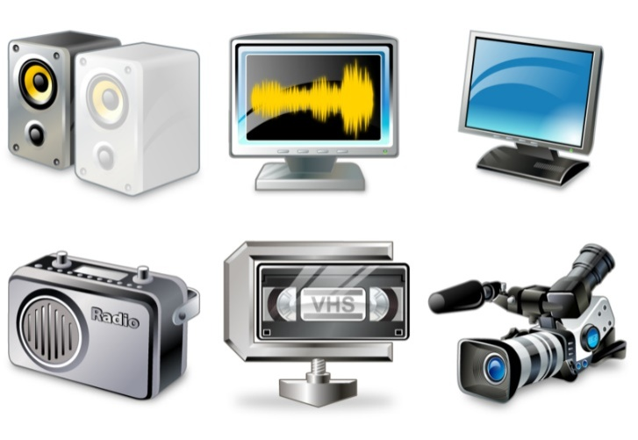




Multimedia
In Computer , Multimedia means that computer information can be represented through audio, video, and animation in addition to traditional media
What is Multimedia Data
Multimedia data refers to data that consist of various media types like text, audio, video, and animation

Slide 4
Types of multimedia data
Text: using a standard language (HTML)
Graphics: encoded in CGM, postscript
Images: bitmap, JPEG, MPEG
Video: sequenced image data at specified rates
Audio: aural recordings in a string of bits in digitized form

Slide 5


What is Multimedia Database
A Multimedia database (MMDB) is a collection of related multimedia data. The multimedia data include one or more primary media data types such as text, images, graphic objects (including drawings, sketches and illustrations) animation sequences, audio and video etc.
Multimedia database systems are database systems where, besides text and other discrete data, audio and video information will also be stored, manipulated and retrieved.

Slide 6
Types Of Multimedia Database
•Linked Multimedia Databases:
  Multimedia database can be organized as a database of metadata(Data about data).This metadata links to the actual data such as graphic, image, animation, audio, sound etc.
  These data may be stored on Hard Disc, CD-ROM, DVD or Online.
  In this database, multimedia elements are organized as image, audio/ MP3, video etc
  Advantage of this type of database is that the size of database will be small because elements are not embedded in the database, but only linked to it.
There are two types of multimedia Database & they are as follows
•Embedded Multimedia Database:
  Embedded Multimedia Database implies that the database itself contains the multimedia objects as in the binary form in the database.
  The main advantage of such kind of database is that retrieval of data will be faster because of the reduced data access time.
  However, the size of the database will be very large.

Slide 7

A Multimedia Database Management System(MMDBMS) is a framework that manages different type of data potentially represented in a wide diversity of formats.
It provides support for multimedia data types and facilitate for creation, storage, access, query and control of a multimedia database.
What is Multimedia Database Management System(MMDBMS)

Slide 8
How data is stored in MMDBMS?
The Multimedia data can be stored in 3 parts.
Multimedia data
Raw Data
(Uncompressed Image)
Registering Data
(Size & coding details of raw data)
Descriptive Data
(Textual numerical annotations)

Slide 9
Characteristics of MMDM
Corresponding Storage Media
  Data must be stored & managed according to their specific characteristics of the storage media
Descriptive Search Methods
  Query must be descriptive & content oriented
View Specific & Simultaneous Data Access
  Same data can be accessed through different queries by different applications
Management of Large Amounts of data
Real time Data Transfer
  Data transfer of real time activity gets higher priority than other database activities
Large Transactions
  Large transactions must be done in a reliable fashion, since it take long time.

Slide 10

Requirements of Multimedia Database(MMDB)
Integration
  Data items do not need to be duplicated for different programs invocations
Data independence
  Separate the database and the management from the application programs
Persistence(Reusability)
Data objects can be saved and re-used by different transactions and program invocations

Slide 11

Continue…
Privacy
  Access and authorization control
Integrity control
  Ensures database consistency between transactions
Recovery
  Failures of transactions should not affect the persistent data storage
Query support
  Allows easy querying of multimedia data

Slide 12
Issues and challenges
Multimedia data consists of a variety of media formats or file representations including TIFF, BMP, PPT, FPX, MPEG, AVI, MID, WAV, DOC, GIF,PNG,TEC
Because of restrictions on the conversion from one format to the other, the use of the data in a specific format has been limited as well.
Usually, the data size of multimedia is large such as video; therefore, multimedia data often require a large storage.
Multimedia database consume a lot of processing time, as well as bandwidth.
  multimedia data structures takes much time in retrieval than standard database structures.

Slide 13
Applications
Digital Libraries
  Documentation and keeping Records
  Knowledge distribution
  Education and Training
News-on-Demand
  Advertisement
Video-on-Demand
  Entertainment
Music database
Geographic Information System
Marketing

Slide 14



Some Largest Databases across the World

Slide 15
References
https://www.slideshare.net/shaikh2016/multimedia-database-58765558?qid=04dad655-d6ca-47df-80a5-0085378eaa54&v=&b=&from_search=5
https://www.slideshare.net/avnishpatel165/multimedia-database-56310108
https://www.slideshare.net/yojana_nanaware/multimedia-db-system

Slide 16


